Slide 1



VIRTUAL MOUSE
Ms. Gagana h p (4mn21cs017)
Mr. pavan m v (4mn21cs033)
Under the guidance of:
Prof. Bharath Bharadwaj B S,
Assistant Professor,
Dept. of Computer Science & Engineering,
Maharaja Institute of Technology Thandavapura

Slide 2
CONTENTS
Introduction
Existing System
Proposed System
System Requirement Specification
Algorithm
Flowchart
Snapshots
Conclusion and Future Enhancement
References
Computer graphics AND IMAGE PROCESSING laboratory – 21csl66
Computer graphics and image processing laboratory – 21csl66

Slide 3
INTRODUCTION
Background: Creating a virtual mouse using OpenCV involves combining computer graphics and fundamental image processing techniques to enable control of a computer's cursor through hand movements or gestures.
Aim: To create a system that allows users to control a computer's cursor and perform various actions through hand gestures and movements.
Purpose: The primary purpose of a virtual mouse project using OpenCV is to explore and develop innovative methods of human-computer interaction by leveraging computer vision and image processing techniques.
Application: Hand Detection, Human-Computer Interaction.
Computer graphics AND IMAGE PROCESSING laboratory – 21csl66
Computer graphics and image processing laboratory – 21csl66

Slide 4
EXISTING SYSTEM
Several existing systems vary in their approaches, complexity, and capabilities, but they all share the common goal of enabling touchless cursor control through hand gestures.
Poor lighting or shadows can cause the system to misinterpret gestures.
The system may struggle to distinguish the hand from other objects.
The system may perform well for some users but poorly for others.
Frustrating the user.
Low-resolution cameras or slow processors can degrade the user experience by reducing detection accuracy and increasing latency.
Computer graphics AND IMAGE PROCESSING laboratory – 21csl66
Computer graphics and image processing laboratory – 21csl66

Slide 5
PROPOSED SYSTEM
A proposed system for a virtual mouse using OpenCV in computer graphics aims to enhance performance, accuracy, and user experience by addressing key challenges.
Enhanced Accuracy and Robustness.
Improved Lighting and Background Handling.
Real-Time Performance.
Object Detection and Recognition.
Computer graphics AND IMAGE PROCESSING laboratory – 21csl66
Computer graphics and image processing laboratory – 21csl66

Slide 6
SYSTEM REQUIREMENTS SPECIFICATIONS
HARDWARE REQUIREMENTS
SOFTWARE REQUIREMENTS
RAM: 4GB
Processor : 2.0 Hz
OS: Windows 10 or later.
Language used: Python
Python version: 3.6 or later
IDE: Visual Studio Code, Eclipse.
Computer graphics AND IMAGE PROCESSING laboratory – 21csl66
Computer graphics and image processing laboratory – 21csl66

Slide 7
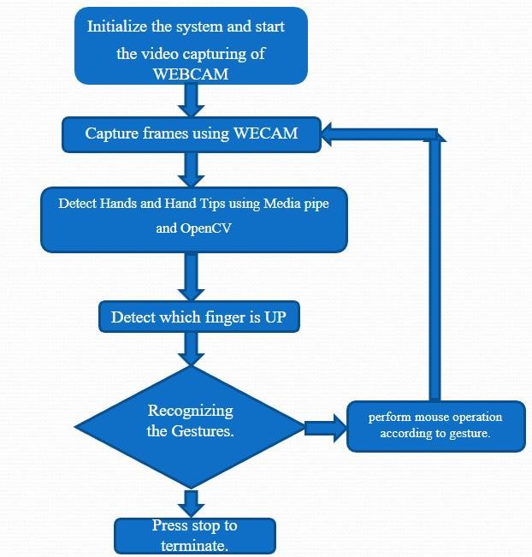
Flowchart
COMPUTER GRAPHICS AND IMAGE PROCESSING LABORATORY – 21CSL66

Slide 8

Any suggestions!
Computer graphics AND IMAGE PROCESSING laboratory – 21csl66
Computer graphics and image processing laboratory – 21csl66

Slide 9

Thank You Listeners!
Computer graphics AND IMAGE PROCESSING laboratory – 21csl66
Computer graphics and image processing laboratory – 21csl66

